Slide 1

THE SOUND OF SPACE
Federico Caroppo
Enrico Dalla Mora
Alberto Doimo
Riccardo Iaccarino
ACTAM project 2022/2023
Professors:
Bruschi Francesco
Rana Vincenzo

Slide 2
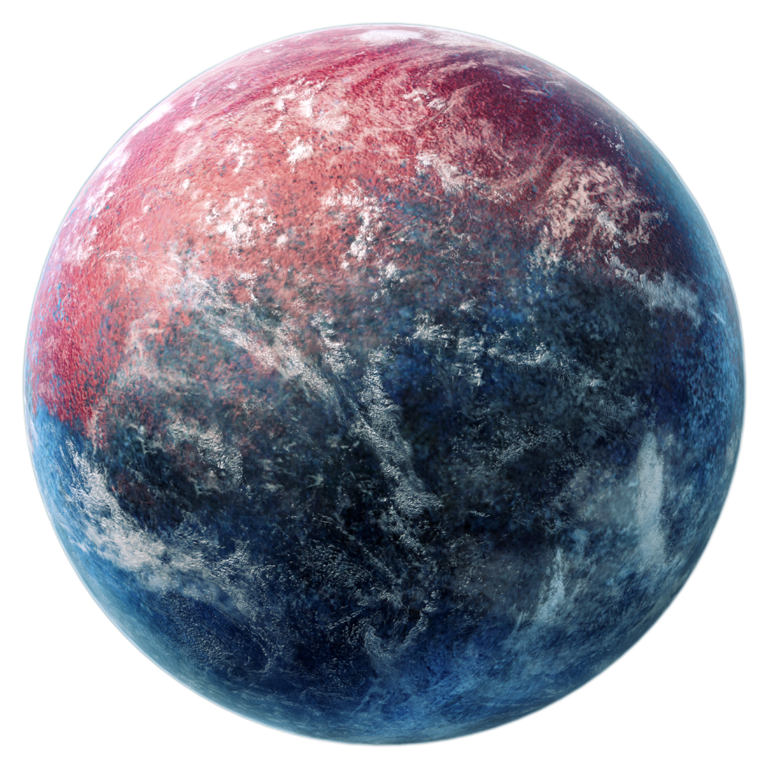
OUTLINE
CONCEPT
PARAMETERS COMPUTATION
GRAPHICAL IMPLEMENTATION
SOUND IMPLEMENTATION

Slide 3
CONCEPT
Generative computer music system
Image processing algorithms to extract qualitative visual data from pictures and convert them to music
Themed tri-dimensional graphics
Solar System as an interactive drum machine

Slide 4
PARAMETERS COMPUTATION
The main idea behind the project revolves around the association between visual features (e.g. colours) and musical features (e.g. the tonality of a piece).

Slide 5
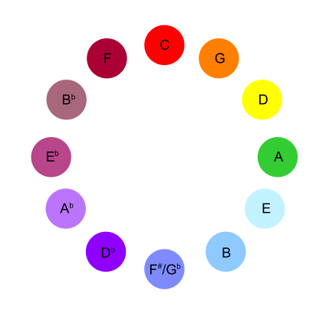
KEY
Average color
Retrievied from image
Calculation of perceptive distance from Skrjabin's key-to-color mapping
Key computation corresponding to minimum distance

Slide 6
Mode
Brightness
Average of RGB coordinates to obtain gray values
Compute the total gray value of the image
Normalize by the canvas area to determine the light level
Label based on a chosen threshold

Slide 7
CHORD TYPE
Lightness
Two possibilities: a simple major/minor triad and a seventh tetrad
Association of chord species with the user-selected image
Algorithm focused on determining the "lightness" of the colors w.r.t. an RGB threshold
Normalization by the total number of pixels

Slide 8
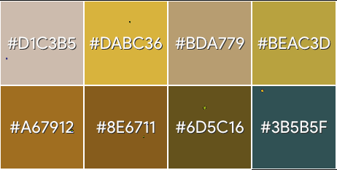
CHORD PROGRESSION
Palette
Captures the “mood” of the image
Extract pixels information building an array of colors
Color quantization through Median Cut algorithm
Size of the palette as complexity of the progression

Slide 9
GRAPHICAL IMPLEMENTATION

Slide 10
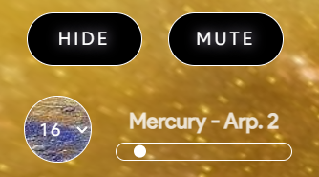
Frameworks choice
Buttons and sliders personalized with ad-hoc CSS classes
User-friendly guide implemented with the library sheperd.js
JavaScript library p5.js for creative coding
Navigation in a WEBGL 3D environment thanks to p5.Easycam

Slide 11
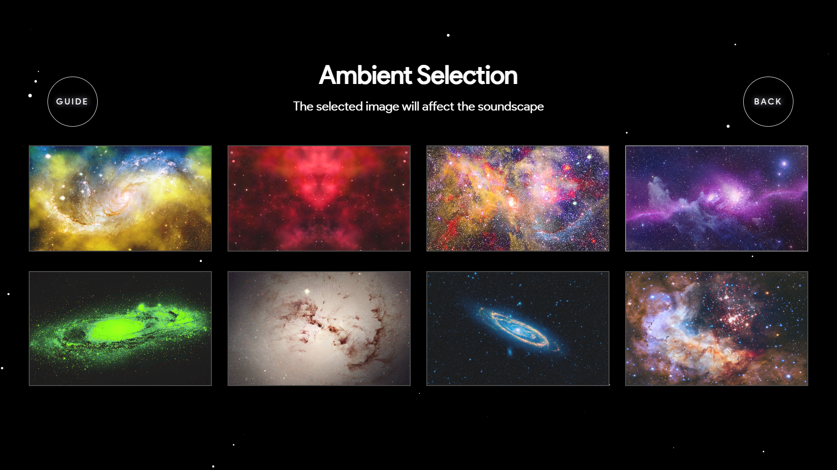
start menu

Slide 12
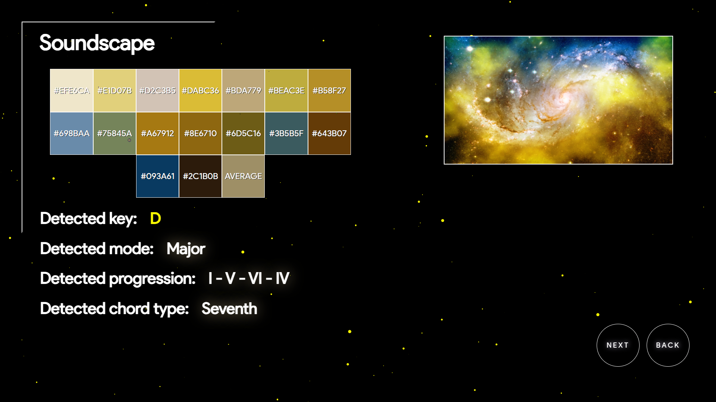
Extracted parameters

Slide 13
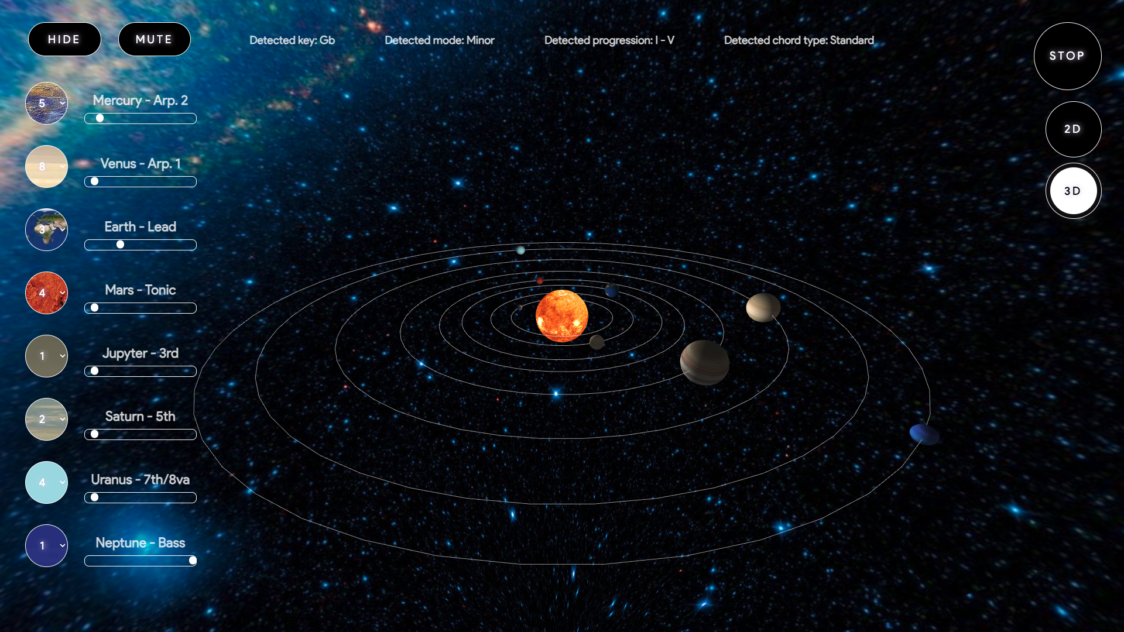
3d visualizer

Slide 14
SOUND IMPLEMENTATION
Subtitle

Slide 15
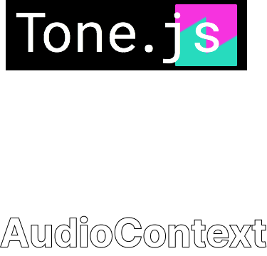
Framework choice
The sound was originally implemented with the library Tone.js
Tone was very inefficient and heavy computationally-wise
Re-implementation of the sound using the AudioContext

Slide 16
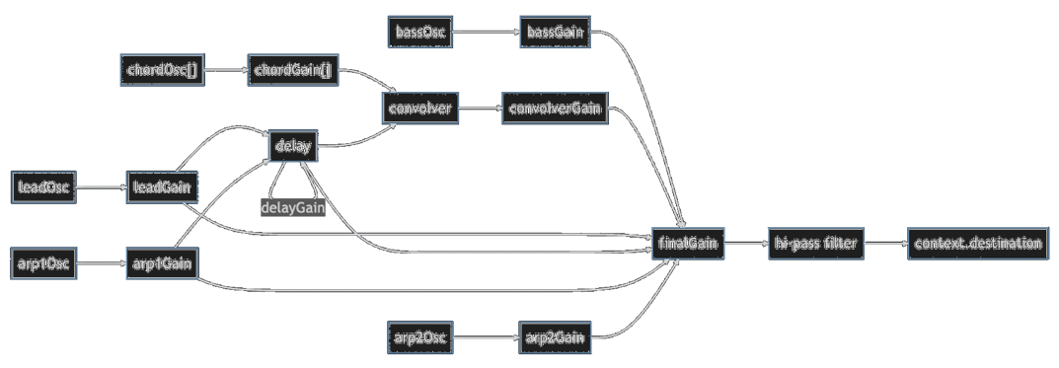
Sound path

Slide 17
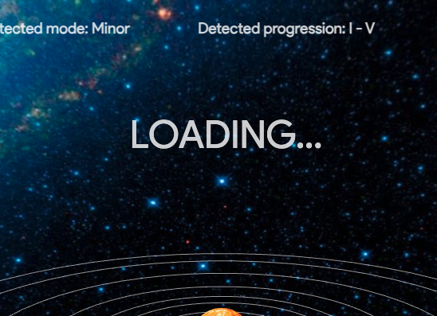
Synchronization
Each planet represents an instrument and is played periodically
Loops and envelopes run the time schedule of the sound
Planets synch with the music thanks to a loading time slot

Slide 18
Possible improvements
Image loading from the user to personalize the environment
Sound recording and downloading
Additional sets of instruments (themed)
Additional customable controls
Performance improvements and stability (audio, graphics)

Slide 19
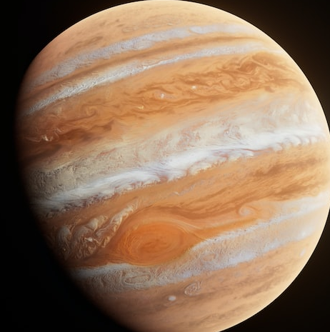
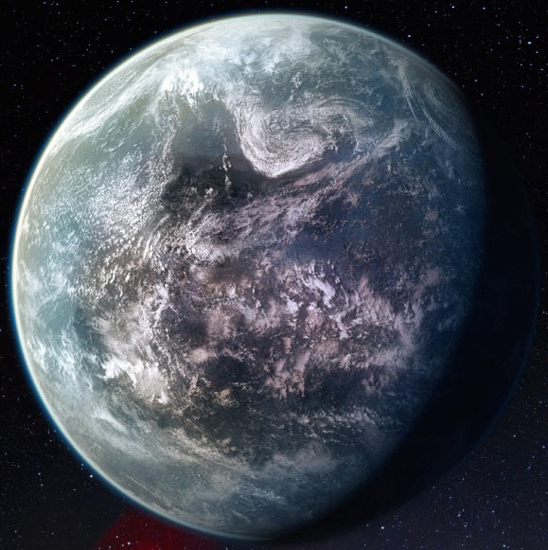
Thanks for the attention

